Slide 1
QMUL
Employment Status: Employed/Self-employed?
Presented by:
Chris Bridgeman Tax Manager, Finance
Kelly Rosa HR Central Services Manager
Janice Trounson Deputy Director of Finance, Financial Controls

Slide 2
What does employment Status mean for QMUL?
Before engagement or any work is begun
When considering appointing an individual to carry work for QMUL, we are required to carry out checks to determine if the individual is either:
(i) an employee and to be put onto a contract of employment and paid through the payroll system with the subsequent deduction of PAYE tax and NI or:
(ii) exceptionally - a provider of services with the requirement to be accepted as a supplier by procurement; have a contract for services; an Agresso generated purchase order and with payment made by Accounts Payable upon receipt of a valid invoice which meets certain HMRC criteria

Slide 3
Why is this important?
Failure to carry out reasonable steps to determine the correct employment status of individuals is a breach of our fiduciary duties as an employer and is also a breach of HM Revenue & Customs Regulations
Payments made to individuals without being taxed presents a risk from an HMRC perspective
This has been highlighted as an area of risk across the sector and is actively investigated during HMRC audits

Slide 4
When does this apply?
On each occasion we are considering appointing an individual to carry out work for QMUL we must follow the same procedure in determining their employment status.
If an individual carries out work on different and non-concurrent occasions the employment status process must be carried out for each instance.
If we already employ a person/people to carry out the same or a similar role anywhere else in QMUL then we are expected to treat the employment status in the same way for new appointments. We would expect academic lecturers, examiners and other core activities to route through payroll
It is the role and not the person that we need consider

Slide 5
What do we require the engager to do?
At this stage no work has been undertaken or contracts issued
You must follow the guidance on the HR website:
HR---Procedures---Contracts terms & conditions---Employed vs Self-employed
http://www.hr.qmul.ac.uk/procedures/contracts/employmentstatus/index.html
By following the guidance here you will either complete a simple questionnaire to provide an “employment” status outcome (routing the payment via HR/payroll processes) or the requirement for a fuller Employment Status Indicator (“ESI”) questionnaire which looks at the role in more detail to provide a definitive answer.

Slide 6
Who completes this?
The engager in the relevant department should complete the ESI
It is important that the ESI is completed accurately, an incorrectly completed ESI may result in the incorrect status being indicated. If we are engaging an individual as an employee or self-employed we should also take evidence of the right to work.
A pdf copy of the ESI should be retained (this is created on completion with a copy of all questions & answers along with a reference number)
The questions change during the completion of the ESI dependent upon the answers provided. NB: No single question determines the employment status outcome!
If we get this wrong this has extremely serious consequences for QMUL and does constitute a breach of the law
If the outcome from the ESI is “not determined” please contact Chris Bridgeman in Finance.
Please do not contact HMRC directly as we have strict contact protocols agreed with them

Slide 7
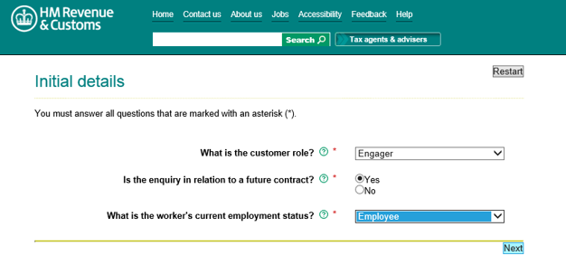
Who is the customer? Workers’ current employment status?

Slide 8
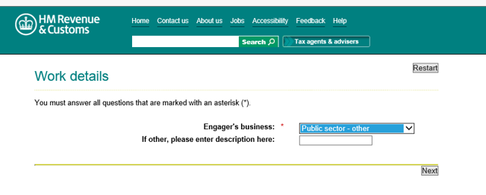
ESI FAQ’s – Who is the Engager?

Slide 9
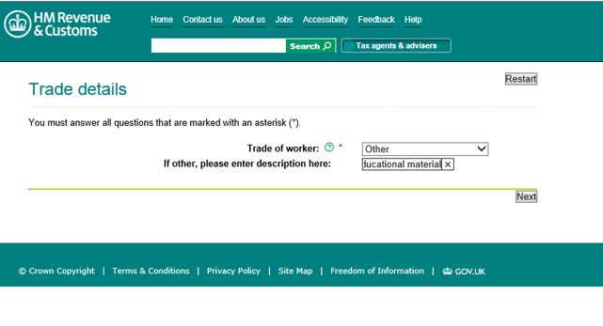
Who is the worker and what is their trade?

Slide 10
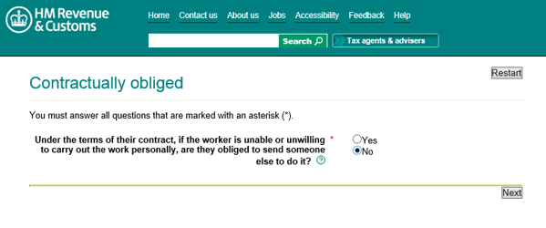
Is the worker obliged to send someone else?

Slide 11
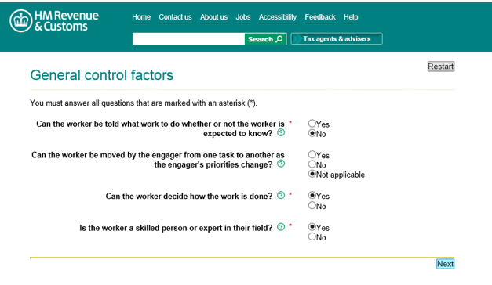
Who controls the worker?

Slide 12
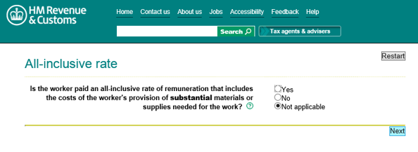
What is the nature of the remuneration?

Slide 13
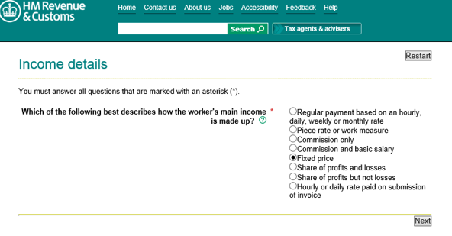
How is the workers main income made up?

Slide 14
Next steps following the ESI result
If the result of the ESI questionnaire is employee you will need to:
Determine the correct way of employing the individual – i.e. should a contract of employment be issued or is it a one-off payment? HR will be able to offer advice as to which is the correct option
For either method a Right to Work Check must be conducted before any work takes place, the individual will also need to complete a Personal Details Form
To issue a contract of employment, the relevant authorisations will need to be sought via i-GRasp

Slide 15
Next steps following the ESI result
If the result of the ESI questionnaire is self-employed the following steps apply;
Discuss with procurement the process for setting up the provider as a supplier and obtain a supplier number from Agresso (finance system). Note in future we will require the individuals NI and evidence of right to work.
Complete the contract for services (standard contract is on the procurement intranet page) http://qm-web.finance.qmul.ac.uk/purchasing/docs/123903.docx, paying attention to the Terms & Conditions specifically in relation to Insurance, VAT etc. The scheme of delegation for contract signature must also be adhered to
Raise an Agresso Purchase order (PO)
The supplier delivers the service
Once completed Goods Receipt (GRN) the PO to the value of work completed
In line with usual P2P process the supplier will send a valid invoice quoting the PO number to Accounts Payable (apinvoices@qmul.ac.uk) in pdf format
Once the PO; GRN and invoice are matched the payment will be made to the supplier within the QMUL standard supplier 30 day terms

Slide 16
What happens if we don’t follow these steps?
An individual may be paid through the wrong channel and not be Taxed correctly or payment will be delayed/not made;
HMRC levy both interest and penalties for failure to tax an individual correctly, which can result in the full amount of tax payable to HMRC and potentially a penalty of up to 100% of the same amount;
HMRC also have the ability to publicly name an organisation who fails to organise their tax affairs and commit errors - this presents a significant reputational risk. (A number of universities were named in the press in 2015);
“Universities accused of reducing tax bills”
“Universities are saving thousands of pounds by paying top academics and staff off the payroll, in a move that could open the door to claims of tax avoidance.”
QMUL will then encounter more scrutiny by HMRC in all of its activities which is both time consuming and costly!

Slide 17
HMRC focus
A change to the treatment of personal service limited company providing services to public sector bodies will take effect from 6.4.2017
There will be new simpler tests and a new online tool to determine if deductions are due following a consultation this summer and the release of new legislation
Care needs to be taken if a service provider indicates this will be through their limited company as HMRC are focussing on personal service companies as a means of tax avoidance
Using a limited company could be a hallmark of tax avoidance
Setting up a company is a complicated and costly exercise: administration, tax returns, pension costs, accountancy and audit costs
We will be required to review our payment arrangements over the last four years and disclose errors where we have treated individuals suppliers incorrectly

Slide 18
Worked examples
An individual is to be engaged to provide a lecture;
An individual advises that they have a UTR and so are self employed;
A student is to be remunerated for showing students the campus on an open day;
………………………………….

Slide 19
Who do I contact if I have a query?
If you have followed the steps on the HR website to determine employment status but have an inconclusive outcome or any other concerns you should contact HR or Finance who should be able to assist:
Kelly Rosa: HR Central Services Manager 020 7882 3168 k.rosa@qmul.ac.uk
Tony Pettit: Head of Payroll and Pensions 020 7882 7705 t.pettit@qmul.ac.uk
Chris Bridgeman: Tax Manager 020 7882 2956 c.bridgeman@qmul.ac.uk

Slide 20
Questions & Answers?

Slide 21
Examples
If you are looking to engage an individual to carry out a discrete piece of work as part of a course module, which of the following is sufficient evidence of self-employment?;
A Unique Tax Reference Number (UTR)
A copy of the individuals Self-assessment Tax return
A verbal confirmation of their status
A fully completed Employment Status Indicator form
None of the above

Slide 22
Examples
If you are looking to engage an individual to carry out a discrete piece of work , which action should you take first in engaging the individual?
A copy of their UTR number
Completion of a contract for services
Request an invoice for the work and send to AP for payment
Completion of an ESI
None of the above

